Slide 1
Ethical Issues
Opposing: Women's Right to have Abortion.

Slide 2
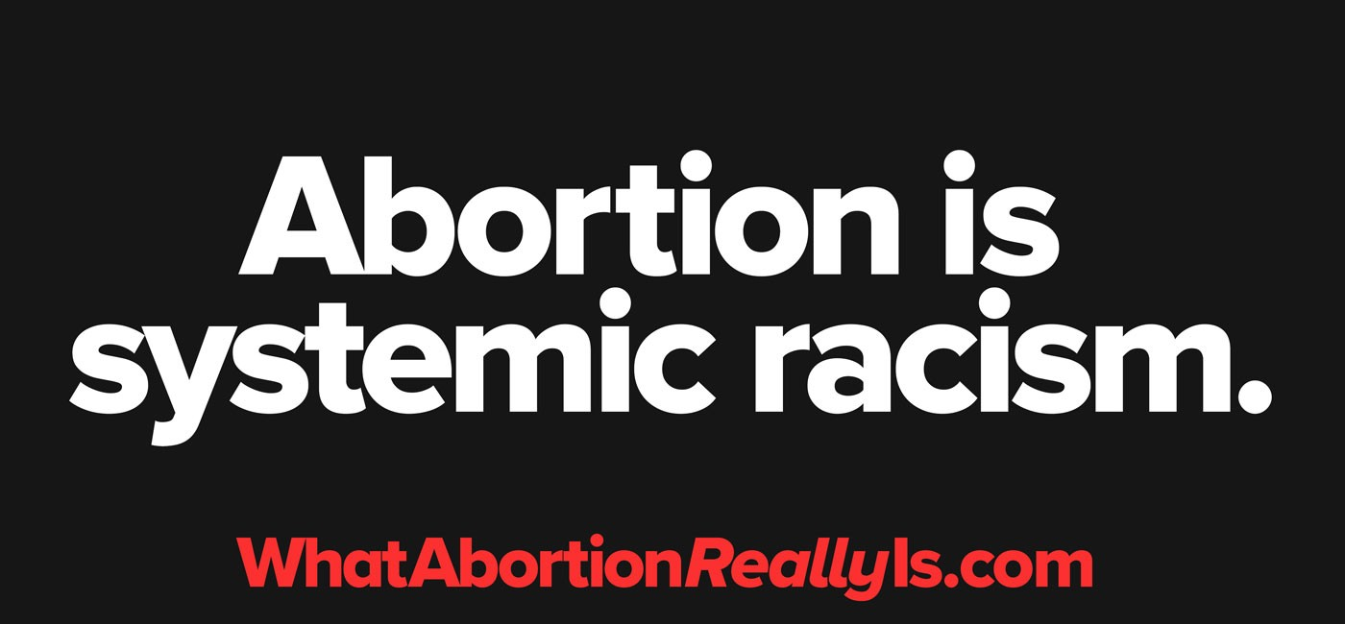
Women's Right to have Abortion
Abortion remains a controversial topic in the United States.
Women are highly discriminated using abortion (Baker, 2018).
Women should not be allowed to abort.
Abortion devalues life.
Notes:
Abortion is one of the most controversial topics of discussion in the United States (Baker, 2018). This is because it is always having those who are proposing and opposing. Nevertheless, abortion devalues life hence it should not be legalized.

Slide 3
Dilemmas or Concerns on Women's Right to have Abortion
The right to abortion is vital for gender equality.
The right to abortion should be part of pregnant rights.
Children are important in society (Boonin, 2019).
Banning abortion puts women at risk of suffering from other conditions.
Notes:
Different concerns regarding abortion continues being discussed depending on the side one supports (Boonin, 2019). As such, abortion devalues the importance of children in society. Legalizing abortion would completely devalue the roles of children in the entire community.

Slide 4
My Rationale on the Issue
As hinted, abortion continues being a very controversial topic in the United States. On the same note, women should not be allowed to have abortion since this will create ethical concerns in society. In other words, abortion is murder as it continues to harm the health and well- being of the mother and the developing foetus. To avoid such ethical concerns, abortion among women should not be allowed. Therefore, I support the fact that women should not be allowed to conduct abortion to maintain excellent health outcomes as well as valuing of children.

Slide 5
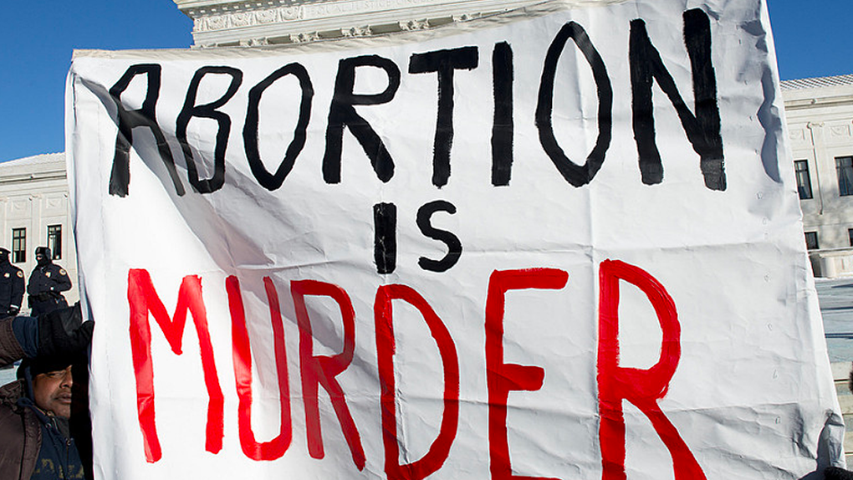
The Key Stakeholders and Factors in Support of the Issue
Policy makers.
The Government (Baker, 2018).
Health.
The future of society.
Notes:
Both policy makers and the government remain to be fundamental in decision-making as far as abortion is concerned (Baker, 2018). The two key stakeholders have the influence of initiating policies that will reduce the rates of abortion in the United States. Again, health and the future of society are critical factors that ought to be considered before making conclusions as far as abortion is concerned.

Slide 6
Ethical Principles Involved
Nonmaleficence is vital in the abortion discussion.
It encourages the doctor to avoid harm (Baker, 2018).
Both the mother and developing foetus should be protected from harm.
Women should be treated equally as men in society.
Notes:
Nonmaleficence remains to be a fundamental ethical principle for abortion (Baker, 2018). In this case, it is the responsibilities of physicians to make sure that the woman is not subject to pain or harm. Women should be treated the same way as men in society as a way of promoting equality.

Slide 7
Access as a Policy Driver
Health care should be easily accessible to every woman (Boonin, 2019).
Women should have access to care at minimal costs.
Policy makers should promote health for women.
Expectant women should be provided with care.
Notes:
Access to health for women should in society should be made a priority (Boonin, 2019). In this case, policy makers should be focussed towards making health accessible to women especially those who are expectant. Therefore, health should be considered as a moral right.

Slide 8

Utilitarian
It encourages conducting the good that benefits society.
The well-fare of society is considered.
Women should not be allowed to abort.
Children benefit society.
Notes:
Decisions on abortion should be based on the well-dare of the society (Baker, 2018). Legalizing abortion will devalue the importance of children since birth rates will significantly go low. To safeguard society, abortion should not be allowed.

Slide 9
Conclusion
Abortion should not be legalized.
Abortion is murder.
It also devalues the importance of children.
Policy makers are fundamental in making abortion illegal.
Notes:
Abortion should not be allowed since it continues to violate the health of women as well as the children. it also violates ethical principles that govern society. Both the government and policy makers are critical in making abortion illegal.

Slide 10
References
Baker, C. (2018). Abortion in America: 45 Years Later. The Texas Orator Blog Entries.
Boonin, D. (2019). Beyond Roe: Why Abortion Should be Legal--even If the Fetus is a Person. Oxford University Press.

